Slide 1




SummarEase
A Text Summarizer
By Malita Lewis

Slide 2


Agenda
Synopsis
Scope of the System
Problem Definition
Limitation
Objectives
Conclusion

Slide 3






Synopsis
Pinpoints and prioritize crucial information while ensuring convergence and readability in the summaries produced.
Not only retains the essence of the original text but also accommodates formats, refines content
Leveraging the power of Tkinter, Python’s NLTK library , cosine similarity and PageRank algorithm develop a comprehensive NLP toolkit within a user-friendly graphical interface

Slide 4

Problem Definition
Information Overload
Complex Data
Time-Consuming Process
Duplicate Information
Challenge for Decision Making
Storing
Navigating Data
Difficult to Grasp

Slide 5

Objectives
To save users time by condensing lengthy text efficiently.
To allow users to identify and extract key points swiftly.
To enable users to digest information rapidly.
To provide rapid access to summarized information.
To improve user efficiency in handling extensive documents.
To ensure user can quickly grasp essential information.

Slide 6

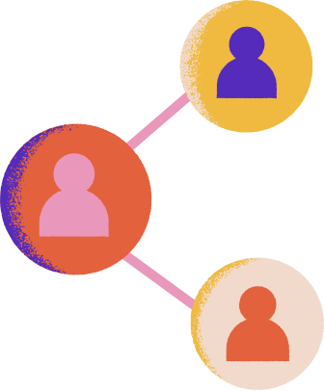


Scope of the System
Target Users: Researchers , Students , Professionals , General User
Potential Applications: Educational Institutions, Content Aggregators, Information Retrieval Systems ,Customer Support.
Scalability: Designed to be scalable, capable of handling large volumes of text and accommodating a growing user base.

Slide 7



limitations
Language Dependency
Ambiguity Handling
Lengthy Documents
Variability in Quality
Loss of Context
Dual Information

Slide 8



Conclusion
The text summarizer offers a streamlined solution for distilling extensive texts into concise summaries, prioritizing efficiency and accuracy. Users can customize the summarizer to their preferences, adjusting parameters to focus on specific topics or keywords. Its accessibility empowers a broader audience to engage with complex information effortlessly.

Slide 9



Thank you !!

